Slide 1

Mortgage Loan Predictor
By Alex Martin

Slide 2

Poll
How many people would like to buy a house/or already own a house?

Slide 3
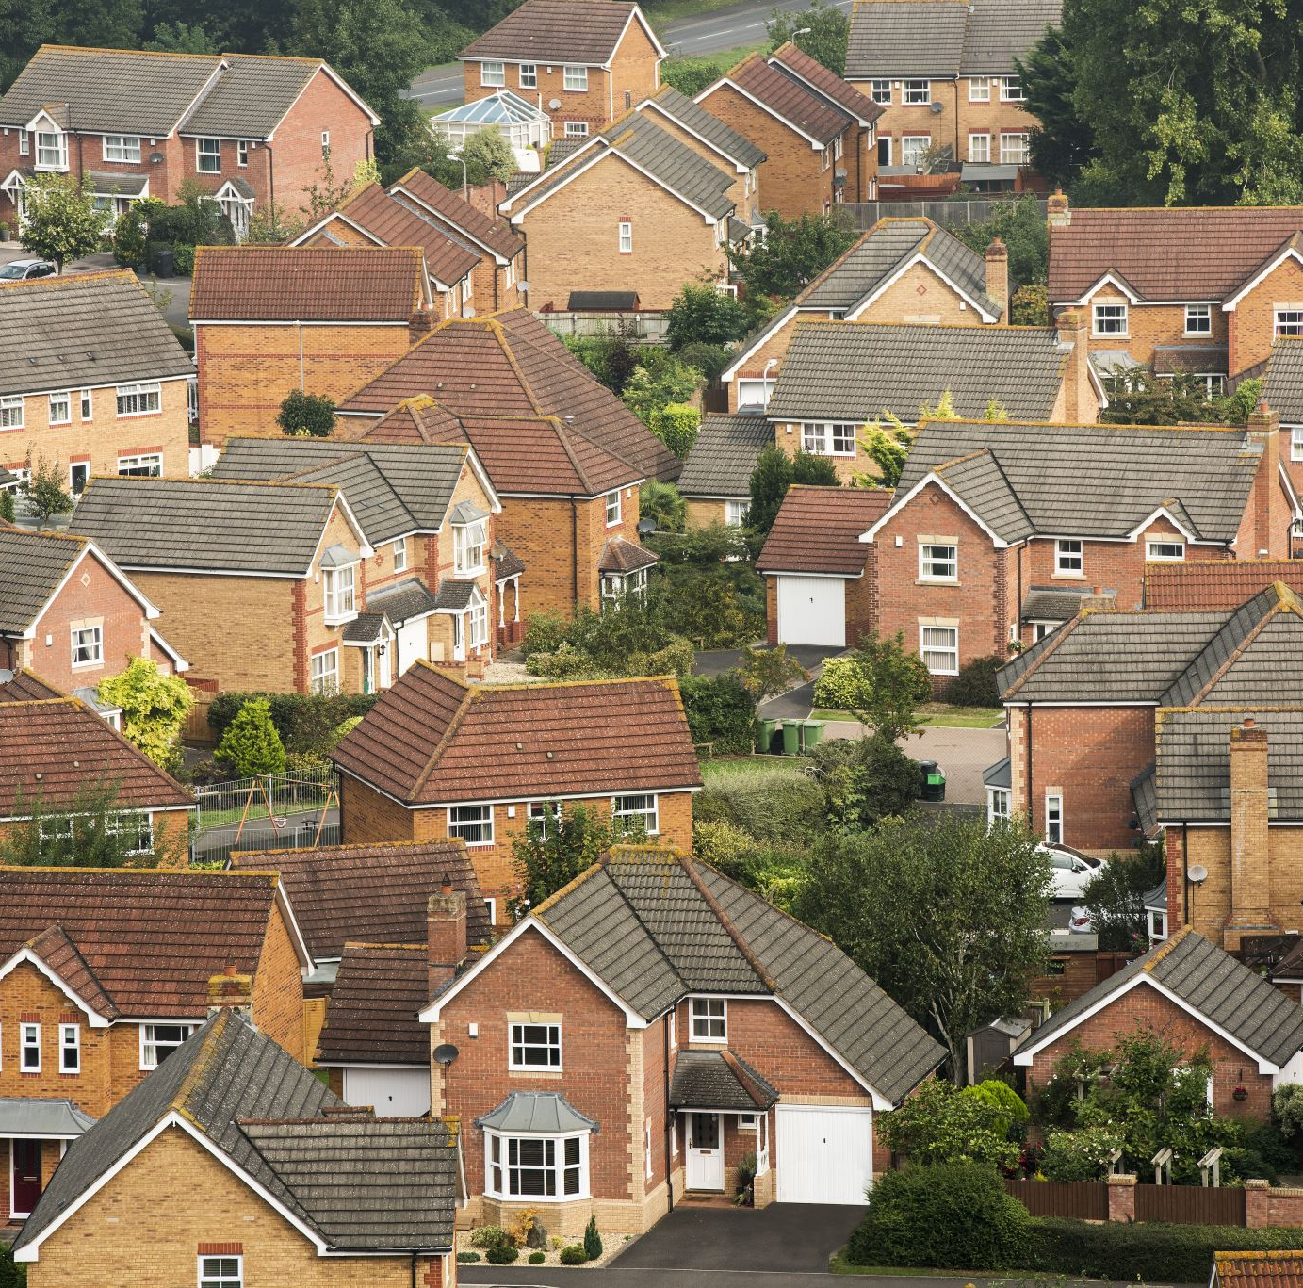
The Situation
Owning a home is highly aspirational and a key life milestone:
Financial stability.
Potential property value appreciation.
Stability.
Free from the whims of landlords.
Fosters a stronger sense of community.
Offers financial security for future generations.
A base to build from.
And many more…

Slide 4

The Problem
“What do I have to do to get a mortgage?”
Mortgage approval process is a ‘black-box’
Denied applications show on your credit report for a year.

Slide 5

A Solution?
Develop a mortgage prediction app that allows users to determine potential approval before submitting official applications.
This will help prevent users from making unnecessary applications that could harm their chances of obtaining a mortgage in the future.
Provide users with reasons for the decision so they know what they need to improve on in the future.

Slide 6

Methodology
Data Collection
Data Wrangling
EDA
Predictive Analysis
Predictor App

Slide 7

Data Collection
https://ffiec.cfpb.gov/data-browser/data/2022?category=states
Notes:
I was unable to find uk data

Slide 8
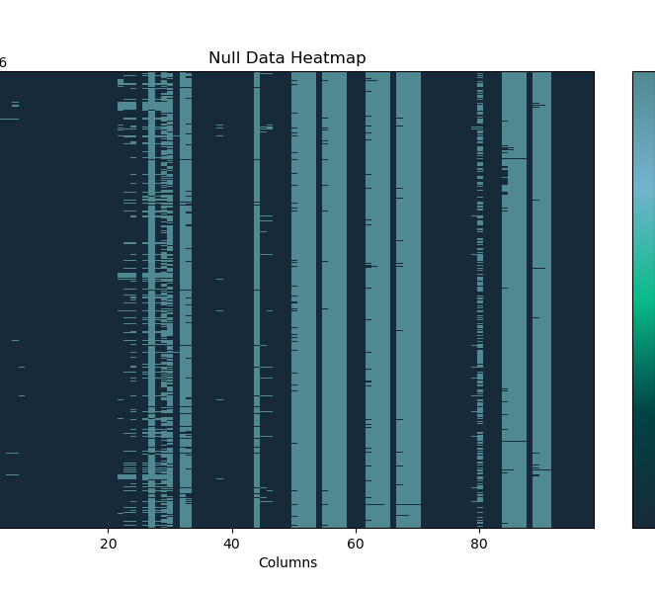
Data Wrangling
Dimension | Count
Row | 5,081,179
Columns | 99
Exemption | Count
‘Exempt’ | 942,042
1111 | 1,756,100
8888 | 8,547

Slide 9

Exploratory Data Analysis

Slide 10
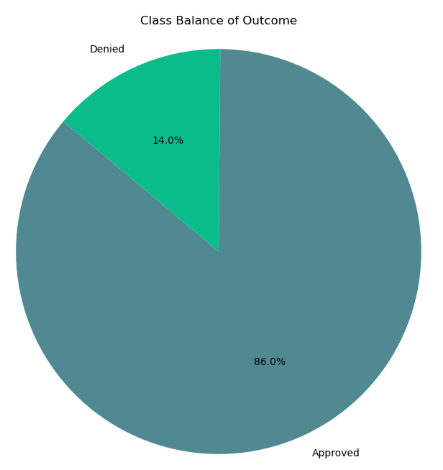
Approved v. Denied
86% of Mortgage loans were approved
14% of Mortgage loans were denied
Large class imbalance in the dataset
Outcome | Count
Approved | 4,362,232
Denied | 713,641

Slide 11
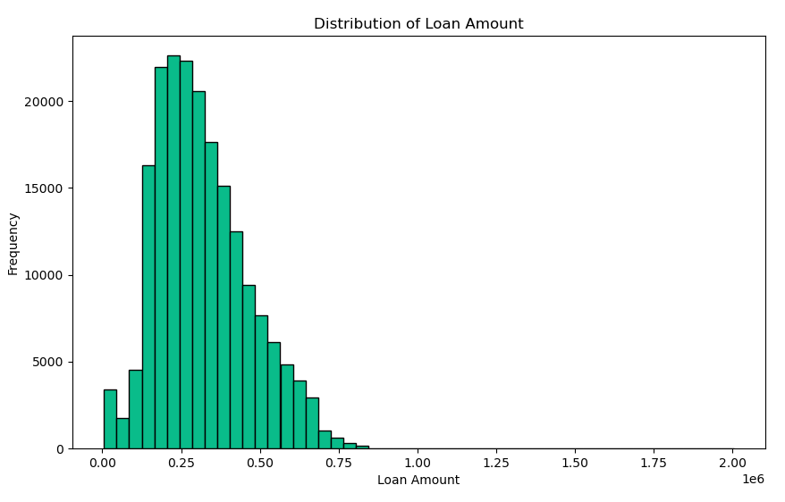
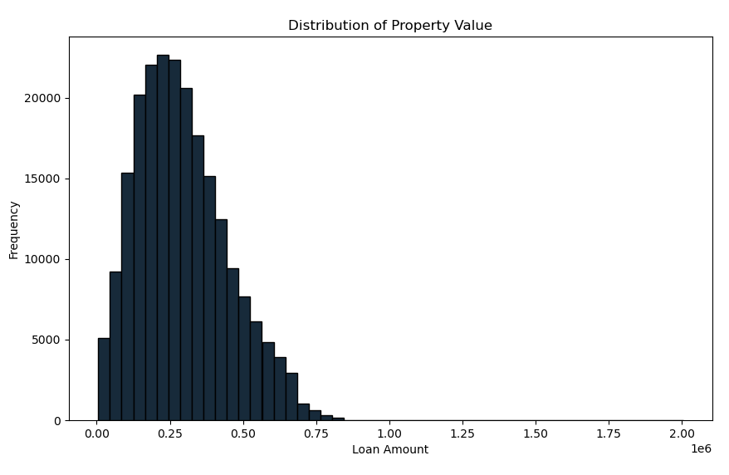
Data Distribution
Median loan amount: $285,000
Mean loan amount: $382,0000
Mode loan amount: $205,000
Median loan amount: $355,000
Mean loan amount: $522,0000
Mode property value: $255,000

Slide 12
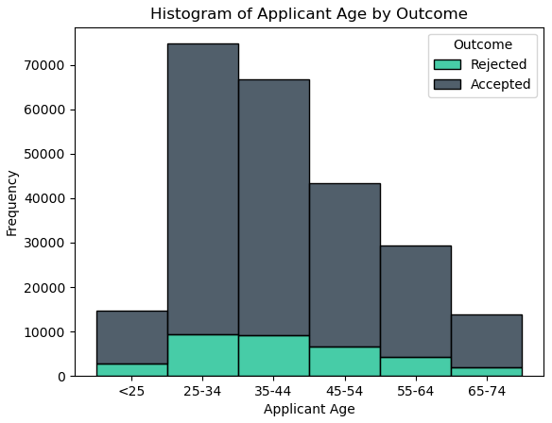
Mortgage Application by Age
The most common age to apply for a mortgage in between 25-34.
Rejection and Acceptance follow the same pattern
There is no age discrimination for mortgage applicants.

Slide 13
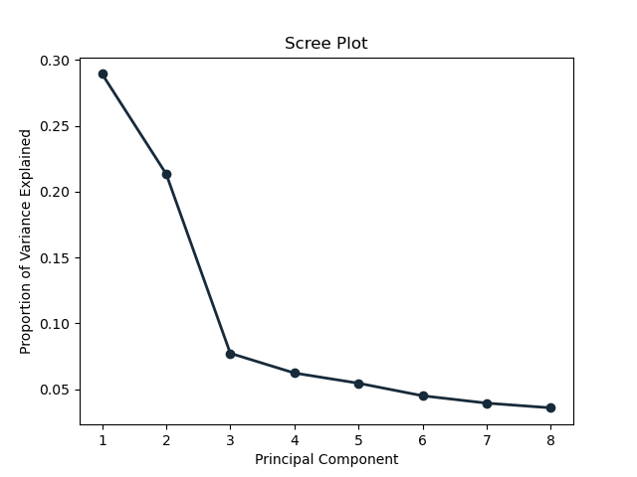
Principle Component Analysis
Principal Component | Proportion of Variance Explained | Cumulative Proportion of Variance Explained
PC1 | 0.289 | 0.289
PC2 | 0.214 | 0.503
PC3 | 0.077 | 0.58
PC4 | 0.062 | 0.643
PC5 | 0.055 | 0.697
PC6 | 0.045 | 0.742
PC7 | 0.039 | 0.782
PC8 | 0.036 | 0.818

Slide 14

Modelling

Slide 15

Measuring model performance
Precision, Recall, F1 score and ROC-AUC to measure the performance.
Precision measures the accuracy of positive predictions.
This is important in my model as a false positive would mean giving someone a prediction of approval for a mortgage and then getting denied.
This would be the worst outcome for my model as customers could damage their credit cores with failed applications.
Furthermore, it would undermine customer trust in the model/function.

Slide 16
Modelling
The are the supervised learning classification models tested:
Random Forest
Logistic Regression
Support Vector Machine
eXtreme Gradient Boosting
Light Gradient Boosting Machine

Slide 17

Model Selection- LightGBM
Gradient Boosting:
Builds models in a sequential manner where each new model corrects errors made by the previous ones.
Leaf-wise Growth:
Unlike traditional boosting methods that grow trees level-wise, LightGBM grows trees leaf-wise. This means it splits the leaf with the maximum loss reduction, leading to a more complex and potentially more accurate model.
Histogram-based Algorithm:
LightGBM uses a histogram-based algorithm to bucket continuous feature values into discrete bins, significantly speeding up the training process and reducing memory usage.

Slide 18
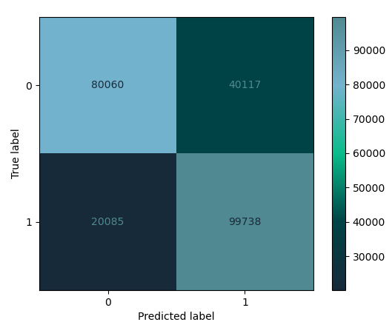
Performance Evaluation
 | Precision | Recall | f1-score
0 | 0.80 | 0.67 | 0.73
1 | 0.71 | 0.83 | 0.77
Accuracy |  |  | 0.75
Macro - Avg | 0.76 | 0.75 | 0.75
Weighted - Avg | 0.76 | 0.75 | 0.75

Slide 19
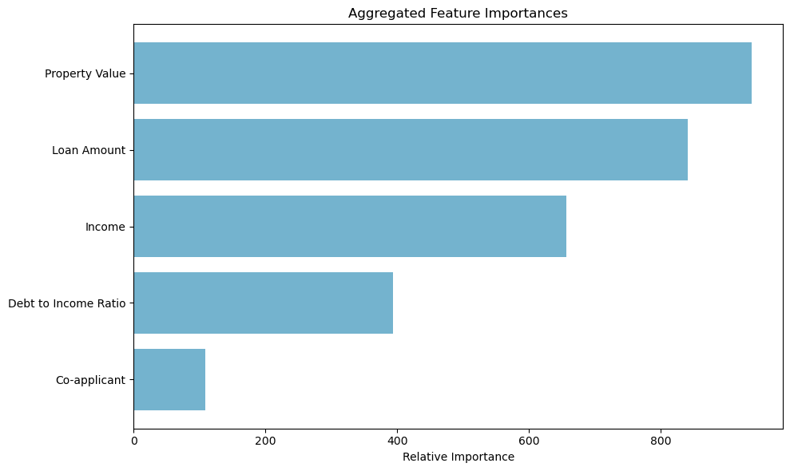
Model Transparency
Model transparency is of utmost importance for this app
Enables customers to understand the factors that made the decision.
Property Value and Loan Amount have the largest effect on likelihood of mortgage approval.

Slide 20
Demo time…

Slide 21

Future Developments
More time cleaning the data.
Computational power for more model tuning.
UK data.
Information on macro lending decisions.

Slide 22
Thank you for your time
Any questions?

